Slide 1
EFV Iliad
Gilgamesh Class Exploration Vessel

Slide 2
EFV Iliad
Gilgamesh Class Deep Space Exploration Vessel
Constructed: Ceres Shipyard
Design Compliment: Human: 385, ALF: 500
Propulsion: 1g Fusion Impulse drive
Commissioned: 2075, Launched 2080

Slide 3
UNES Iliad
Mass: (With Fuel) 5.36 x 10¹⁰ kg
  Approx 51 Nimitz Class Supercarriers
Diameter: 850m
Length: m
Habitable Surface Area: 1.81 x 10⁶ square meters
  448 Acres
  336 American Football Fields
Habitat divided into 6 spheres
Each sphere has 30 levels

Slide 4
EFV Iliad - Mission
Exploration of 18 Scorpii (http://solstation.com/stars2/18sco.htm)
  Searching for habitable world
  Establishing a forward operating base
Travel Distance: 45.7 ly
Travel Time: 15.1 years (Earth time: 95.2)
Mission Launch date: March 14, 2080

Slide 5
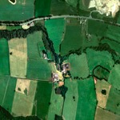
Nimitz Class Carrier (Comparison)
Collision Armor / Radiator
850m
Reaction Flywheel
Cargo Handling
Docking + Hanger
Facilities
Propulsion Thrusters

Slide 6
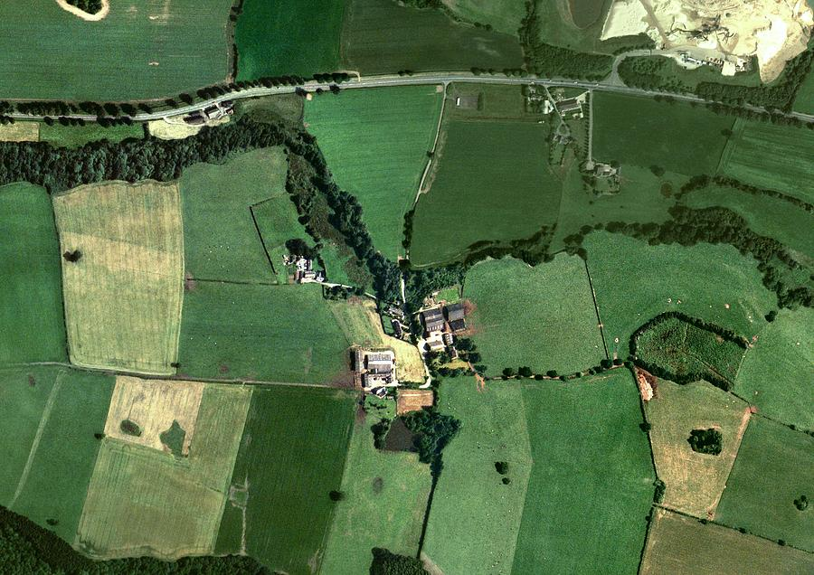
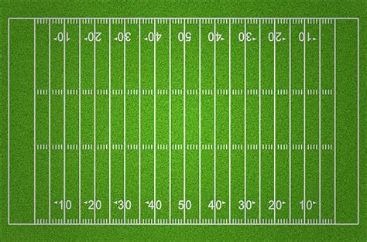
Widest Level
Level 22
Level 41
210 m
American Football Field (Comparison)
Level 43

Slide 7
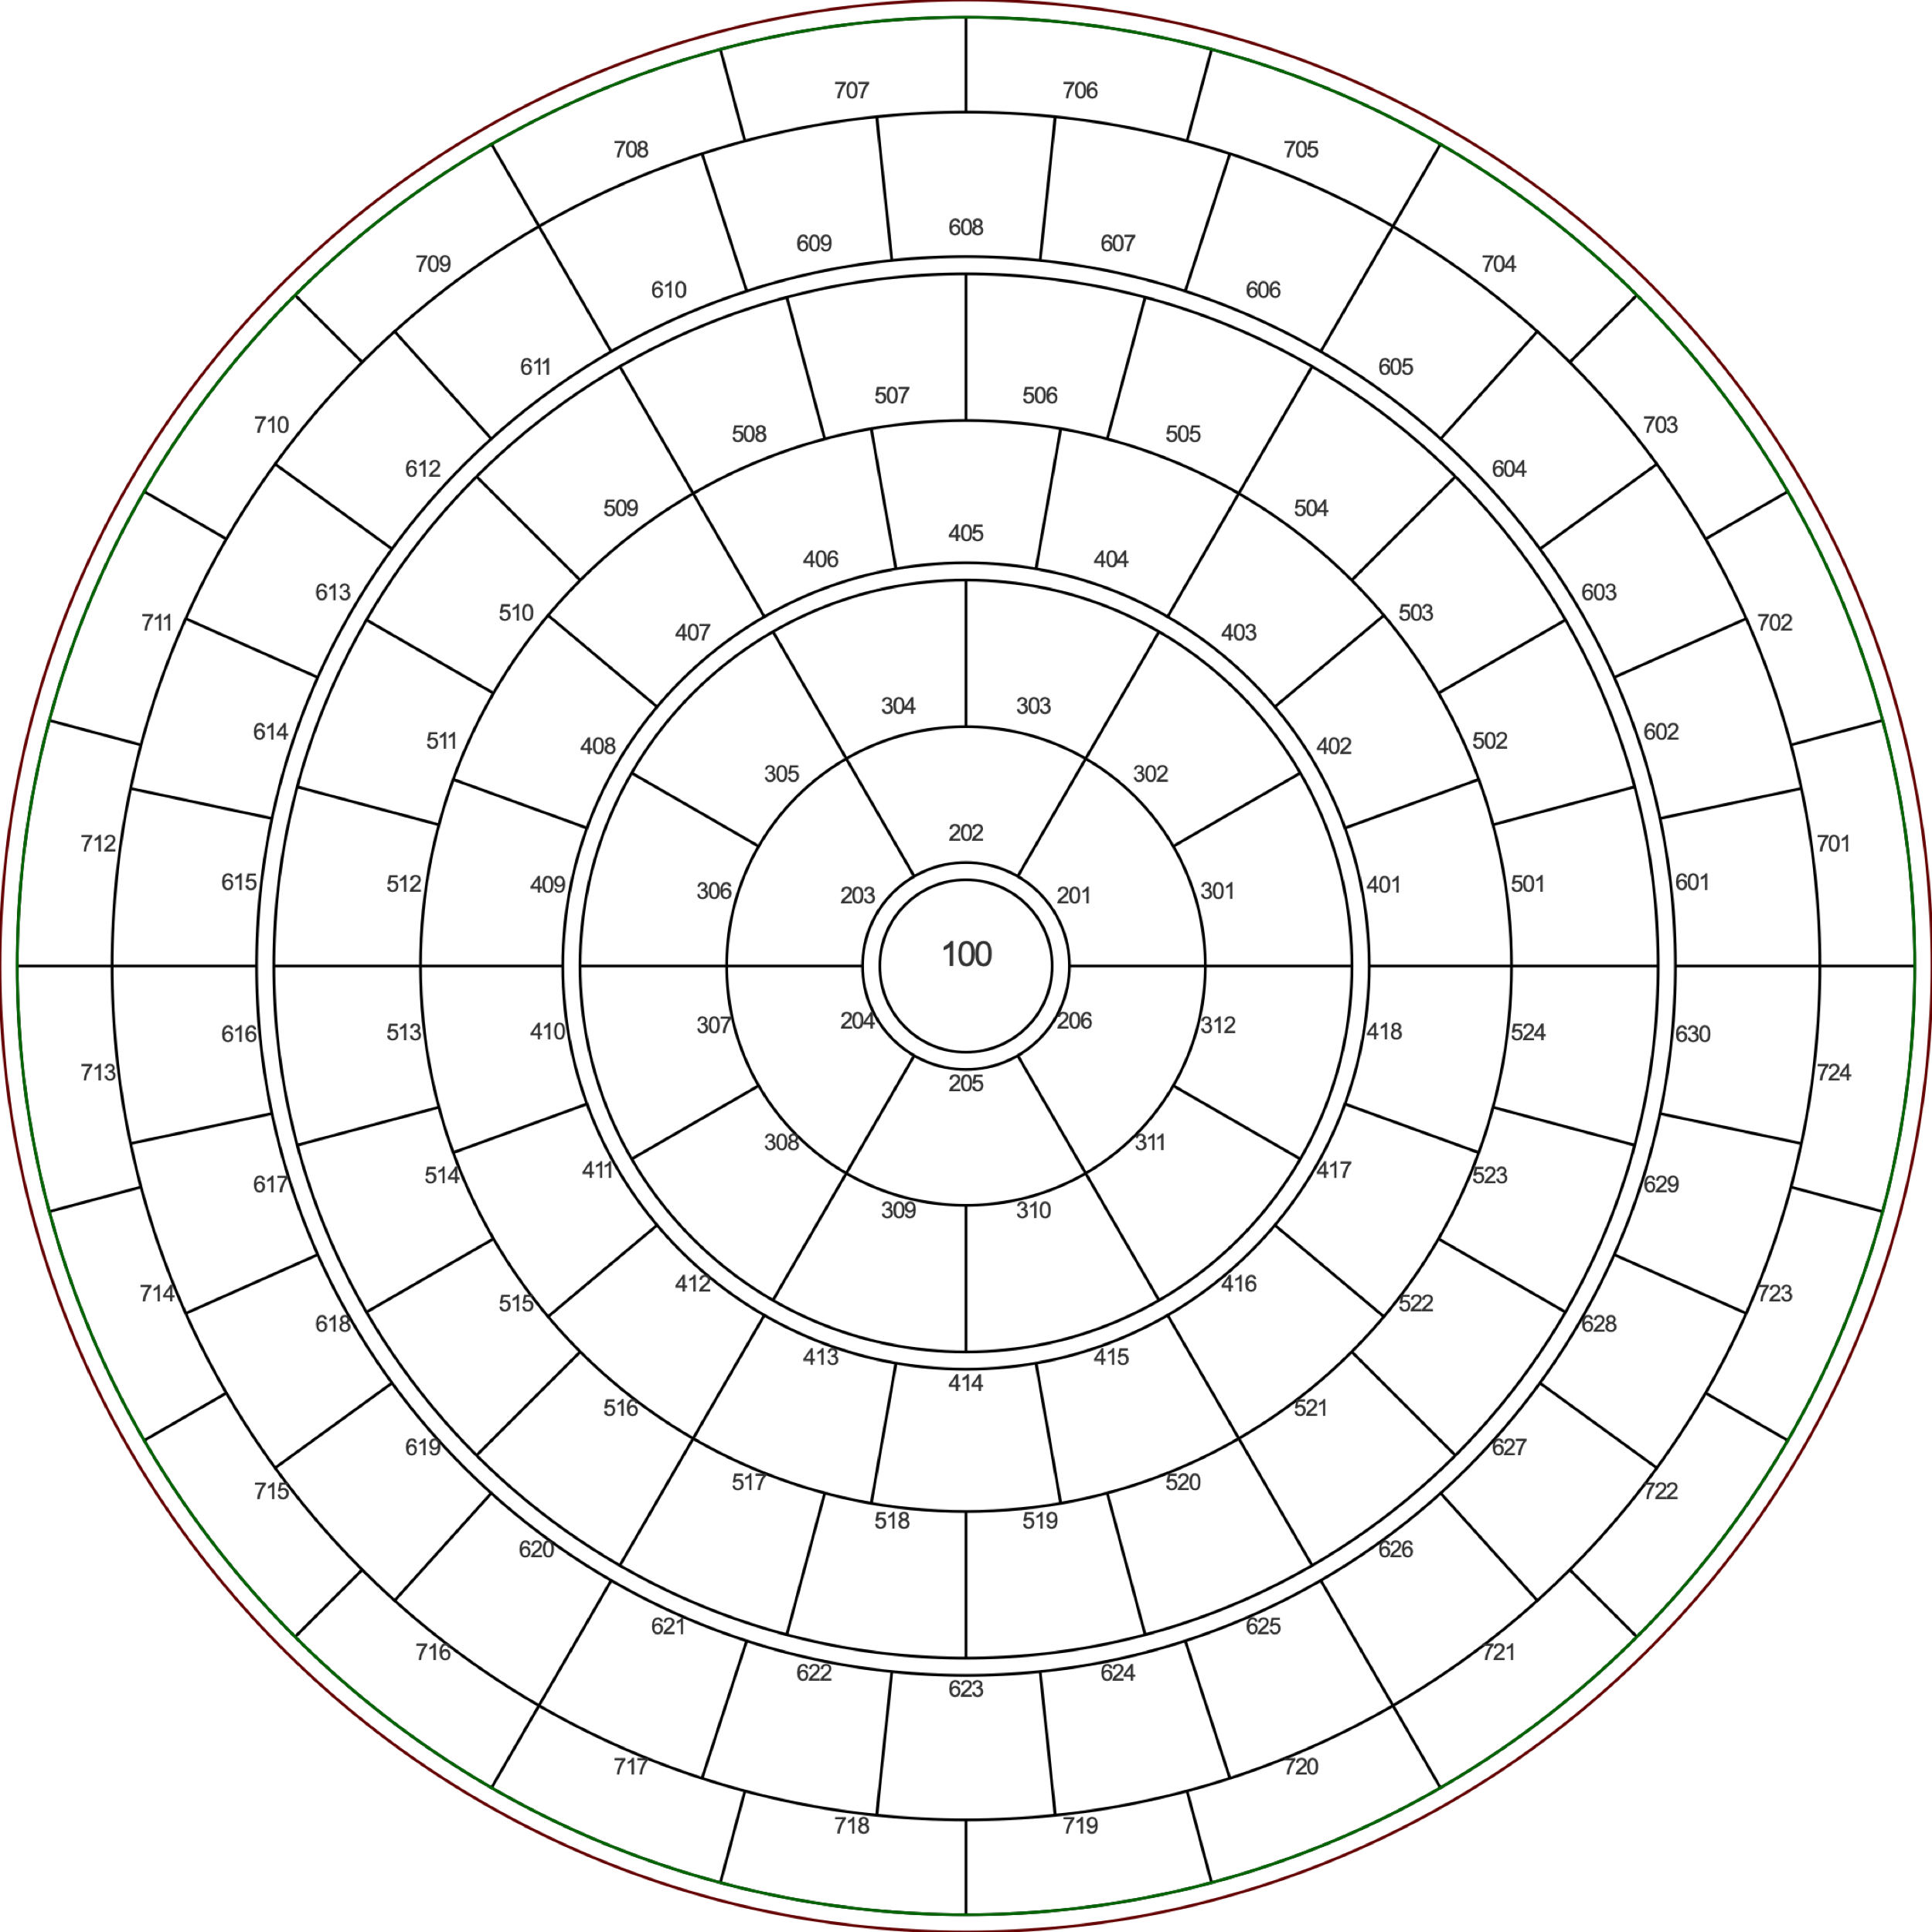
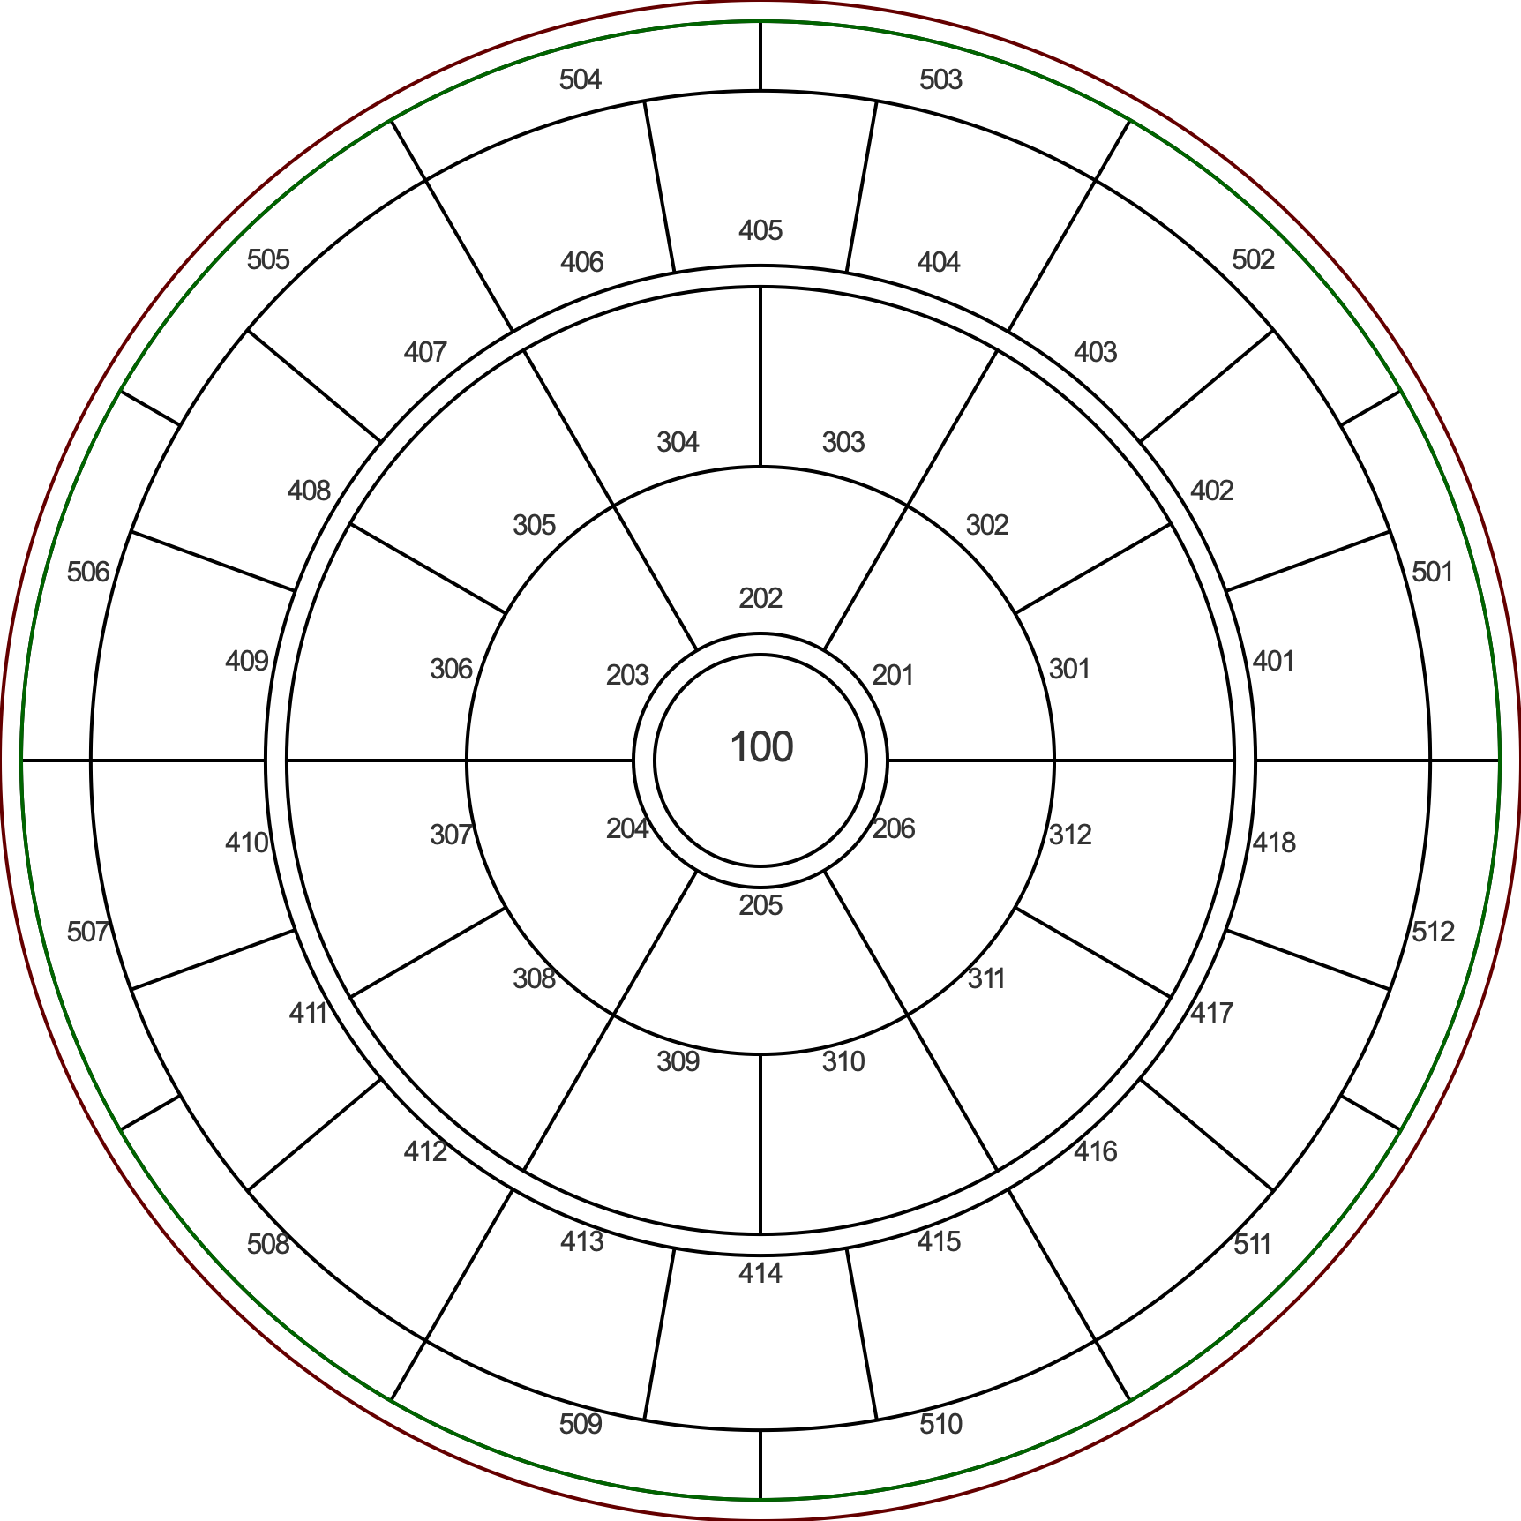
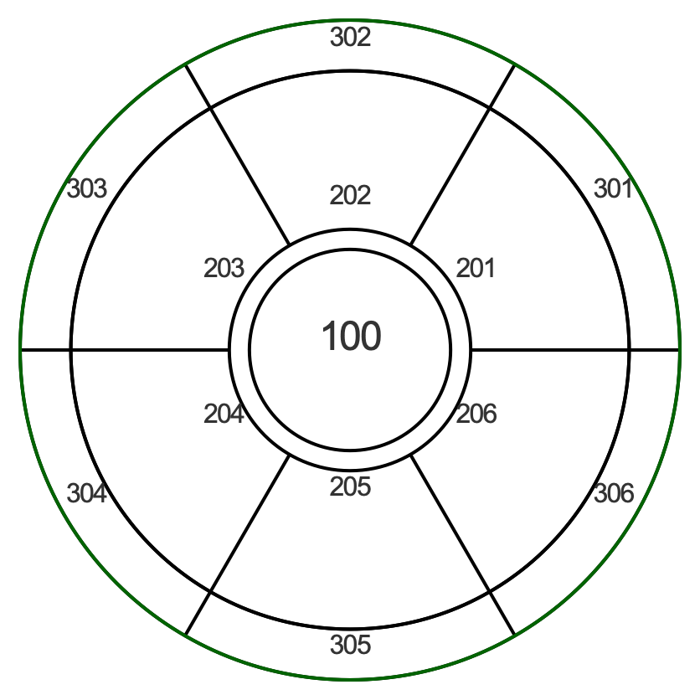
Decks are divided into sectors of roughly equal area

Slide 8
Artificial Gravity
Vehicle Accelleration
Centrifuge
Thrust Mode
Coast Mode

Slide 9
6 Habitat Spheres
Each 137.5 Meters in diameter
Levels are 5 meters apart
30 Levels
3.02e5 m² (74 acres)
10% of floor area unallocated

Slide 10
6 Habitat Spheres
Thrust Phase: aligned with the thrust vector of the craft
”Gravity” equal on all floors (usually 9.8m/s²)

Slide 11
6 Habitat Spheres
Coast Phase: habitat rings rotate at ~1.5rpm
”Gravity” on the lower levels is 9.8m/s² (1 Earth gravity)
“Gravity” on the upper levels is 4.9m/s² (1/2 Earth gravity)
Spheres rotates clockwise
Flywheel rotates counter-clockwise

Slide 12
Cosmic Ray Sheilding
Each habitat sphere is encased inside an outer sphere, and insulated by 10 metric tons of water and metal per m² of surface area.
Cosmic ray penetration protection equivalent to the 2 atmospheres of the Earth
Neutron bombardment enriches water in the insulation into Deuterium and Tritium.

Slide 13
Power and Lighting
LED lighting covers entire “land” surface.
Max luminosity per square meter equivalent to daylight on Earth
Color can be adjusted to tailor lighting conditions
Power system rated to deliver 1kw of power per m² of land surface
Peak Electrical Output: 66 megawatts
Daily power usage: 25600 Mwh

Slide 14
A “Main Street” connects all 6 spheres that equator
Communications between sphere is possible through 2 access tunnels bored through a bearing at the hinge point
Of each sphere. These access tunnels can be hermetically sealed in an emergency.

Slide 16
Habitation
Habitation is concentrated around the the levels near the equator
  Between levels 20 and 24
500 square meters (~5300 square feet) is allotted for each citizen. That figure includes shared spaces like cafeterias, libraries, laundries
Many areas in the habitation area span multiple decks to produce a sense of having sky above

